Slide 1
Planet imagery and land cover
March 1 2019

Slide 2
Creating 2018 land cover and crop timing maps

Slide 3
Need to make 2018 land cover and timing maps because most Planet imagery with high temporal resolution is 2017-2018
For land cover map, used GEE file LandCover/Soy Classification Trial 1
Mask soy_pts_agsat_1 with mapbiomas3 agri
Chose to use soy_pts_agsat1 over soy_pts_1. soy_pts_agsat_1 produced higher accuracy than soy_pts_1 (e.g. 70% vs 60%) but soy_pts_1 has some data in Matopiba whereas soy_pts_agsat_1 doesn’t. The training points will eventually change so it doesn’t matter that much.
Train classifier using Jake’s method/inputs. Classifier to be trained using samples from all years (pooled); however, each year splits the sample points into training/testing points differently
NOTE, don’t have 2018 mapbiomas3 so had to replace it with 2017 mask
Mask final classified image with map3 agri
Export asset as LandUse/base_soymap_agsat_year
In GEE file LandCover/Soy Classification Masking, take the individual years’ base_soymap_year assets and turn them into a single image collection called base_soymaps.
For crop timing map, first need to create 2018 land cover map
GEE file Timeseries_Analysis_Modis/Timeseries Analysis v10 (difference from v9: uses map3 instead of map2.3 as mask; uses my land cover maps instead of Jake’s land cover maps)

Slide 4
Creating validation data from Planet imagery

Slide 5
Planet imagery workflow
Uploading planet images as GEE asset
Properties of each image in PlanetLabs folder
Year, Month, Day
Satellite
PS_analytic_4band
RE_ortho_analytic
PS_ortho_analytic
Asset name is same as the description used in downloading from Planet web site
Lookup table in desktop has Planet order number and description and GEE asset name
Step | To do | Script/web site
1 | Find locations, years where Planet images are needed. Keep info on shp name, image name(s), and dates downloaded in Image_Lookup file in Google Drive | GEE: LandCover/Planet Image Selection
2 | Download cloud free, high temporal resolution Planet images (may need to pare down on locations, years) | Planet web site. Keep downloaded images in desktop
3 | Upload images as GEE assets | In desktop, keep tabs on asset id, polygon name, etc.
4 | Delineate individual fields, natural veg, agri, urban (houses) and center pivot in Planet imagery, and export as asset into the folder Planet Validation Data. The difference between fields and agri is that the fields contain individual (usu square) fields for timing observation purposes, whereas the agri contains lumped agri for land classification (natural vs agri) purposes. Assets are exported as ‘raw_agri_fc_poly1_year’, etc | GEE: LandCover/Planet manual Field Delineation or Planet OBIA
5 | First import the Planet images and make custom visualizations for each, and map each with its own custom vis. Step through fields in CAR poly and record observed crop timing, export observations as feature collection to asset. Assets are exported as ‘timing_obs_for_polyName_in_year_part#’. Make sure to change the ‘part#’ BEFORE entering obs! 0 for SC, 1 for DC, 3 for TC or DC + failed first crop (2 is other agri in Jake’s classification) | GEE: Planet Create Validation Data v2
6 | Import timing and land cover feature collections. May need to combine timing feature collections into a single fc. Turn feature collection of observations into validation image (might need to first merge multiple obs fcs into a single one), use to do validation. The following are turned into dictionaries of images (or simply images): the observed plant/harvest times; the observed cropping intensity; the observed land cover (agri - 10, center pivot - 20, natural - 30, urban – 40). Use images to do validation of timing and land cover maps. | GEE: Planet Do Validation

Slide 6
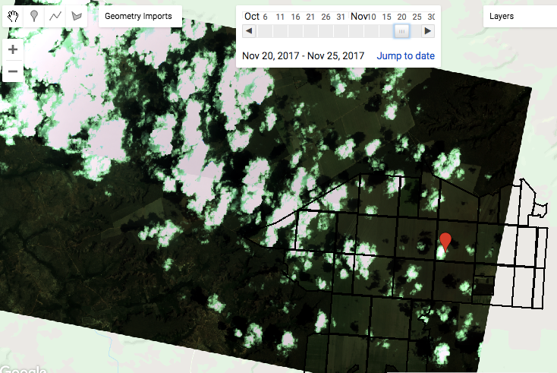
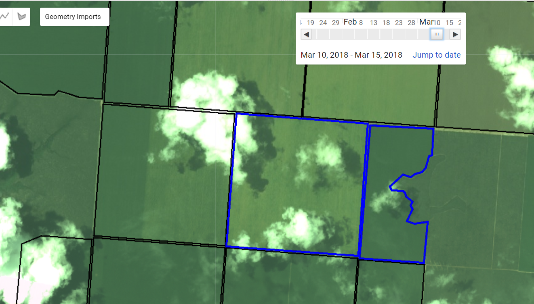
Notes
This week, worked on poly1 crop timing info. Take pictures of the data from each field and enter them all at the same time; can’t guarantee the code will be running for the many hours it takes to create a timing validation dataset
In some images, there’s a green sheen over the entire image so need to compare the field to the natural vegetation to see whether the field is actually green
The use of images from different satellites, and the presence of clouds (and therefore a change in visualization params) makes it hard to have temporally consistent images – i.e. sometimes a field will look like it’s mature one day but totally green next week, which means the ‘mature’ day was probably green and was just sensed with another satellite.
Try to download from the same satellite, and low presence of clouds. 4bandPSanalytic looks the best; there seems to also be more PS than RE images. Reortho and Psortho both have had some images that look ‘greenwashed’. In the future, before stepping through images to get timing, pay attention to what the images look like (compared to natural vegetation, known bare/harvested regions, etc)
Don’t download images within 5 days of each other because won’t be able to step through them (I have 5 days as the step interval)
Reorthoanalytic and PSorthoAnalytic both have greenwash effect sometimes. Pay attention to how the image looks in Planet website.
Note that sometimes dark green vegetation can look black/brown; look at natural vegetation to see whether a very dark field might actually be a very green field
Sometimes a stripe-y lightly green field won’t pick up on some satellites and it’ll look bare
Don’t download images with significant cloud cover because it will mess up the visualization parameters, making the rest of the image look too dark to see anything.
Download an entire year from Aug 1 to July 31, because there might be many cycles of crops at unusual times. Look at all times of greening in an image to make sure get all the important images.
GEE file: LandCover/Planet Create Validation Data v2
Lots of clouds -> visualizing based on 90th percentile will make image look weird. This is 4bandPSAnalytic
PS Ortho Analytic greenwashed example

Slide 7
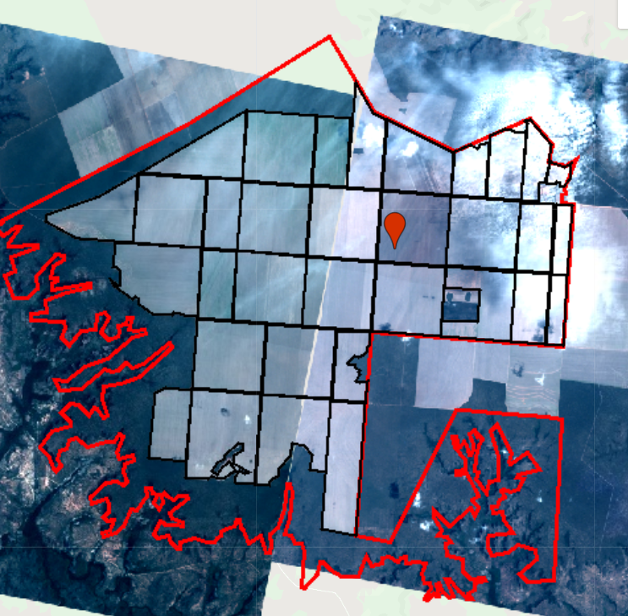
Careful – two images of the same field look different, have different levels of green in them! Takeaway is that it may be helpful to have a set satellite and a set vis params to make sure everything is consistent? Also, clouds in the right image might be getting in the way of accuracy in the color appearance. A simpler way is to be wary of things that look at little bit green, since it might actually be bare.

Slide 8
Next

Slide 9
General problems with land cover classification:
1. Training data are few (especially outside of MT) and perhaps erroneous
New MT training data from Avery
Pool existing training data across years
Create new training data from:
Planet images
Google Earth Pro (visual inspection for soy vs nonsoy)
2. Don’t know what characteristics can best separate classes
Spectrally: Band by band scatterplots to get vegetation index
Phenologically: Temporal principal components
Trial and error: Test different input data

Slide 10
Issue 1: soy vs nonsoy classification is inaccurate
Not enough training data for soy vs non soy in original dataset
There’s a lot of timing variation within soy, perhaps more than for soy vs nonsoy
Solution:
Use new training dataset based in MT (GEE asset ‘MT_ground_reference_data_PLOS_2017’, 675 points from 2003 to 2015)
Train a single classifier across years (to pool up nonsoy agri training points)
Improve the input data by determining what separates soy from nonsoy
Spectrally: Create band-by-band scatterplots using Sentinel in GEE. Look at multiband indices.
Phenologically: Temporal principle components applied to individual pixels to find principle trajectories that give the most variation
See the full variety of soy vs non soy timing. See whether SC/DC soy varies more than soy vs nonsoy
Use this information to update input data (right now: 8 day aqua composite + 32 day Landsat NDVI + terrain)
Create new soy vs nonsoy training in Matopiba and other areas of Brazil
Visually: Take the set of existing training points and look in Google Earth Pro for row patterning of soy vs nonsoy to create new training points
Search for more ground truth data… upcoming survey of soy farms in Brazil
Issue 2: SC soy vs DC soy classification is inaccurate
Sensitive to the set of input training points. Potential reasons:
Training points aren’t capturing the range of SC vs DC, or are badly geolocated
Input bands aren’t temporally refined/appropriate
Solution:
Generate training data for crop intensity, especially outside of MT, using Planet imagery. Pay attention to triple cropping/failed first crops – add more nuanced crop intensity classifications. Add in new training dataset (PLOS) for MT. Use these to redo SC/DC classifications.
Temporal principle components: categorize trajectories of SC vs DC to pinpoint what can best separate them in each region
New input bands:
Peak detection method -> dates of peaks (use dates of certain events, in addition to actual EVI values, as training)
Sentinel 2 (higher temporal resolution)
Issue 3: center pivot classification
Solution:
Take the difference of the annual min and max EVI, use the difference to find the circle. Then do object based classification of the circle in GEE. Try this with Sentinel for higher revisit time compared to Landsat (get irrigation in recent years)
Doesn’t solve raster -> vector issue at scale, but could avoid certain densities of center pivot using only the raster layer
Ask Jill Danes at Stanford about center pivot in Brazil

Slide 11
Next:
Under OBIA script in GEE training, for object based image analysis, see if can automatically get me individual fields
Ask Gabriel if can visually see difference between soy and nonsoy, and list all the potential nonsoy crops options
For center pivot detection, normalize the difference in max and min EVI. Also try to keep the object oriented classification as an image with integers as band values to prevent the raster to vector conversion that’s so hard to scale up
Select new Planet imagery locations in Mato Grosso
Dense area of soy training points
Colab: best way to use Python API with GEE (ipython notebook server)
Do pip install earthengine-api in colab to get virtual machine
Import ee
ee.Initialize()
ee.batch.Task.list() – proves can use earth engine
Docs: github/earthengine-api -> python -> examples -> ipynb -> example stuff

